Slide 1
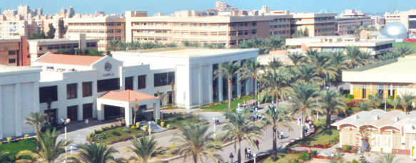
Proposal for AAST IT Infrastructure for Carbon Reporting and VVB Establishment

Slide 2
Carbon IT Infrastructure
For Current Project (AAST Carbon Report):
Establish an IT system to calculate, monitor, and report AAST’s carbon footprint accurately and efficiently.
For Future Goal (VVB):
Position AAST as a trusted VVB capable of verifying and validating external carbon projects using advanced tools such as AI, IoT, and remote imagery.

Slide 3
Goals for Carbon Reporting
Ensure Operational Efficiency:
Transition from manual data collection to automated workflows.
Enable real-time monitoring of emissions and energy use via dashboards.
Improve Accuracy and Data Health:
Collect structured data on energy use, waste, and emissions.
Strengthen Stakeholders Awareness and Informed Decision-Making:
Provide insights into AAST’s carbon footprint.
Promote sustainability initiatives based on data-driven decisions.

Slide 4
Phase 1 – Data Acquisition Overview
Build a centralized platform to collect energy, waste, and emissions data.
Develop structured data submission tools (forms, batch uploads, APIs).
Create role-based dashboards for stakeholders, data owners, and administrators.
Generate automated reports with visualizations (charts, graphs).

Slide 5
Deliverables for Phase 1
Centralized Database: Secure storage for energy, waste, and other raw data.
Data Submission Tools:
Online forms for departmental data entry.
Batch uploads for large datasets.
APIs for automated submissions.
Role-Based Dashboards:
Data Owners: Submit and review departmental data.
Stakeholders: View overall sustainability metrics.
Administrators: Monitor progress and generate reports.
Automated Reports: Generate PDF and Excel reports with visualized metrics.

Slide 6
Stakeholder and Data Owner Responsibilities (Phase 1)
Data Owners (Department Heads and Staff):
Collect accurate data on energy use, waste, and emissions.
Submit data via provided tools (forms, APIs, or batch uploads).
Review and verify submitted data for accuracy.
Stakeholders (Leadership, Sustainability Committee):
Review dashboards to monitor progress and identify improvement areas.
Administrators (IT and Sustainability Teams):
Set up the centralized database and dashboards.
Provide training to data owners on submission tools.
Monitor data submissions and ensure reporting timelines are met.

Slide 7
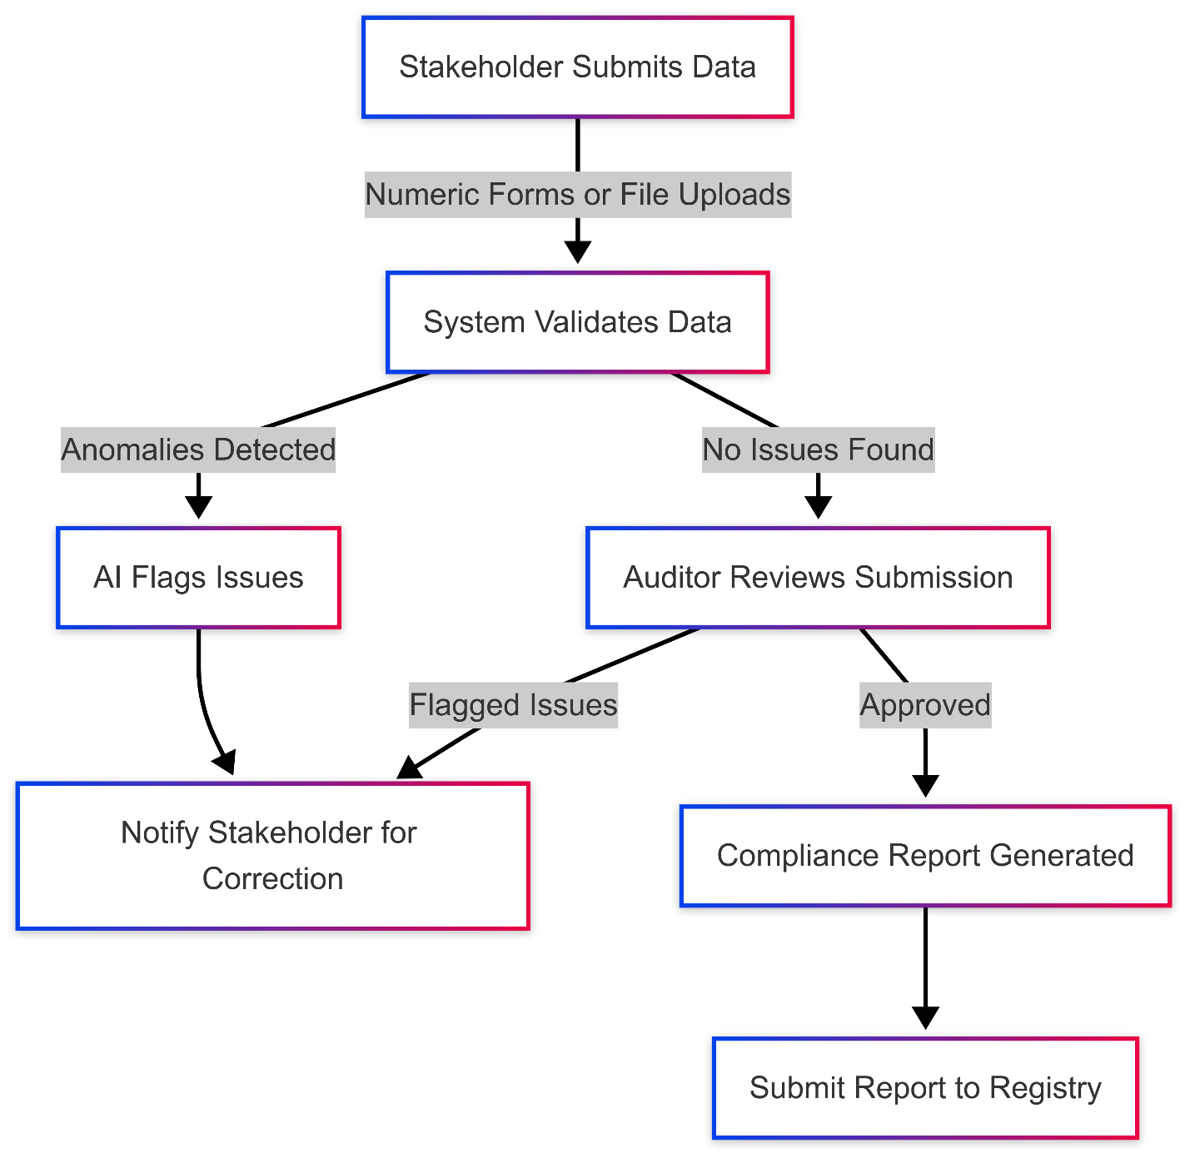

Slide 8
Phase 2 – AI and IoT Overview
Deploy AI models to detect anomalies and provide actionable insights.
Use IoT sensors for real-time monitoring of energy, water, and waste.
Automate data ingestion from IoT devices into the centralized system.
Expand dashboards to include real-time IoT data visualization and predictive analytics.

Slide 9
Deliverables for Phase 2
AI-Powered Insights:
Detect inconsistencies in entered data.
Provide recommendations for optimizing energy usage and reducing waste.
IoT Integration:
Real-time monitoring of energy, water, and waste.
Automated alerts for anomalies detected by IoT sensors.
Enhanced Dashboards:
Real-time IoT data visualization.
Predictive analytics to forecast emissions trends.

Slide 10
Vision for VVB Establishment
Establish
Establish AAST as a regional leader in carbon project verification.
Build
Build a scalable IT infrastructure for validating and verifying external projects.
Leverage
Leverage advanced technologies (AI, IoT, satellite imagery) to ensure transparency and accuracy.

Slide 11
Phase 1 – VVB Foundation Deliverables
Scalable IT Architecture:
Design systems to handle external project validation.
Ensure ISO compliance.
Stakeholder Portal:
Engage project developers.
Share AAST’s sustainability and verification efforts.
Basic Validation Workflow:
Develop workflows for validating external project submissions.

Slide 12
Phase 2 – VVB Advanced Tools
AI Models for Verification:
Detect anomalies in external project data.
Extract key data from documents using NLP.
IoT for Remote Monitoring:
Collect real-time emissions data for external projects.
Automate validation workflows for IoT data.
Enhanced Dashboards:
Provide real-time compliance feedback.
Include predictive insights for project developers.

Slide 13
Phase 3 – Market Integration and Automation
Carbon Market Integration:
APIs for integration with Verra and Gold Standard.
Automate issuance of verified carbon credits.
Smart Contracts:
Use blockchain to automate project validations.
Enable automatic approvals for compliant projects.
Support for Emerging Standards:
Adapt system to new methodologies.
Expand AAST’s presence in global carbon markets.

Slide 14
Thank you

